Slide 1
RED AUTHENTICITÉ
Submitted by-
Himanshu Beriwal (RA1811028010007)
Rushil Rai (RA1811028010022)

Slide 2
Acknowledgement
We wish to thank Dr. B. Amutha, Head of Department, Department of Computer Science Engineering, SRM Institute of Science and Technology, for her valuable suggestions and encouragement throughout the period of the project work.
We are extremely grateful to our Academic Advisor, Dr. S.Ganesh Kumar, Associate Professor, Department of Computer Science Engineering, SRM Institute of Science and Technology, for her great support at all the stages of project work.
Our inexpressible respect and thanks to our guide and also our Faculty Advisor, Ms. S.Priya, Assistant Professor, Department of Computer Science and Engineering, SRM Institute of Science and Technology, for providing an opportunity to pursue the project under her mentorship. She provided us with utmost help and opportunities to explore. She has been a very passionate mentor and her passion for Computer Science and Problem Solving inspired us all through our journey.
We sincerely thank staff and students of the Computer Science and Engineering Department, SRM Institute of Science and Technology, for their help during my research. Finally, we would like to thank my parents, our family members and our friends for their unconditional love, constant support and encouragement.
Expressing our gratitude

Slide 3
Introduction
Abstract:
Red Wine is one of the most popular and renowned Alcoholic beverages around the world. With such demand, arises a major problem of Quality Assurance.
Since, fermentation of any good quality wine takes weeks, assurance of quality becomes tougher. Physical and manual Quality testing has proven to be ineffective and insufficient in the recent times.
Software solutions to be able to determine quality of Red Wines is absolutely necessary.
Problem Statement:
Developing a Prediction Model using Machine Learning to determine the Quality of Red Wines distributed.
Problem Statement & Abstract

Slide 4
Objective
Objectives:
Collecting and Maintaining a Large and Clean Dataset which is to be modelled to analyse quality of wine.
Define various parameters and fields according to which Quality shall be predicted, e.g. Fixed Acidity, Volatile Acidity, etc.
Use various Machine Learning Algorithms and Techniques which will help us rate the Quality of various different Wines.
Further classification and rectification to be done to achieve maximum results and accuracy.
Test out model in real world and refer with experts.
What do we plan to achieve?

Slide 5

LITERATURE REVIEW

Slide 6
Selection of Important Features and Predicting Wine Quality using Machine Learning Techniques
This Paper, presented by Yogesh Gupta, used Linear Regression, Support Vector Machine methods and Neural Network techniques to Predict Wine Quality.
Advantages –
Performed over a very large dataset and uses 11 physico-chemical characteristics.
Disadvantages –
Works better with fewer characteristics, becomes less accurate when those specific characteristics are not considered.
Year of Publication - 2017

Slide 7
Prediction of Quality for Different Type of Wine based on Different Feature Sets Using Supervised Machine Learning Techniques
This Paper, presented by Satyabrata Aich, Ahmed Absi, Kueh Lee Hui and Mangal Sain, used Genetic Algorithm and Simulated Annealing for Feature Selection and Support Vector Machines to Predict Quality of Wines.
Advantages –
Various different models tried, Usage of combinatorial optimization method.
Disadvantages –
SA and GA based feature sets don’t provide the highest accuracy.
Year of Publication - 2019

Slide 8
Wine Quality Prediction using Machine Learning Algorithms
This Paper, presented by Devika Pawar, Aakansha Mahajan and Sachin Bhoithe, used Random Forest Decision Trees, Support Vector Machines and Stochastic Gradient Descent techniques to Predict Quality of Wines.
Advantages –
Data Splitting was Performed and Data was highly processed.
Disadvantages –
Accuracy lower than other implementations.
Year of Publication - 2016

Slide 9
Quality Prediction of Red Wine based on Different Feature Sets Using Machine Learning Techniques
This Paper, presented by Nikita Sharma, used Logistic Regression, Support Vector Machines, Random Forest and Decision Tree techniques to Predict Quality of Wines.
Advantages –
Most number of Models tried and Up to 100% accuracy achieved in certain cases.
Disadvantages –
Very high Delta of Accuracy, Model can underperform up to 48%.
Year of Publication - 2020

Slide 10
Using Data Mining for Wine Quality Assessment
This Paper, presented by Paulo Cortez, Telmo Matos and Jose Luis Reis, used Logistic Regression, Support Vector Machine and Multilayer Perceptron Neural Network techniques for Wine Quality Assessment.
Advantages –
Utilization of Neural Networks, HIghly apt SVM and HIgh Accuracy. Disadvantages –
Slightly old as compared to other papers, hence misses out on few later advancements in techniques.
Year of Publication - 2009

Slide 11
Classification of Cape Gooseberry Fruit According to its Level of Ripeness Using Machine Learning Techniques and Different Color Spaces
This Paper, presented by Wilson Castro, Jimy Oblitas, Miguel De-La-Torre, Carlos Cotrina ; Karen Bazán and Himer Avila-George , used Twelve classification models were developed by combining four machine learning techniques, (such as artificial neural networks (ANN), support vector machines (SVMs), decision trees(DT), and K-nearest neighbor algorithms(KNN))with three color spaces (RGB, HSV, and L*a*b*) for classification of Cape Gooseberry according to level of ripeness.
Advantages –
The principal component analysis combination of color spaces and machine learning techniques improved the performance of the models.
Disadvantages –
Increased complexity of models. Not all combinations have the same accuracy.
Year of Publication - 2019

Slide 12
Review on Prediction of Heart Disease Using Data Mining Technique with Wireless Sensor Network
This Paper, presented by Prachi Jambhulkar and Vaidehi Baporikar, used Naive bayes (Naïve bayes is a classification technique based on probability theory to find out most likely significant possible classifications), J48 decision tree and bagging techniques for Prediction of Heart Diseases.
Advantages –
This system can be used for providing enhanced healthcare services to cardiac patients. Thus, the early diagnosis of heart disease detection may reduce the chances of death in cardiac patients. Disadvantages –
Making the model after physical testing is not feasible.
Year of Publication - 2015

Slide 13
Classification of Paddy Rice Using a Stacked Generalization Approach and the Spectral Mixture Method Based on MODIS Time Series
This Paper, presented by Meng Zhang, Huaiqing Zhang, Xinyu Li, Yang Liu, Yaotong Cai and Hui Lin, used support vector machine, random forest, k-nearest neighbor (kNN), extreme gradient boosting (XGB), and decision tree techniques for Classification of Paddy Rice.
Advantages –
The proposed method achieved high classification accuracies in paddy rice mapping at large scales.
Disadvantages –
A number of factors could affect the accuracy of paddy rice mapping when using the proposed method- temporal resolution of the MOD13Q1 dataset ,the residual cloud contamination in the 16-day MODIS time series EVI and the selection of machine learning classifiers in the stacking algorithm.
Year of Publication - 2020

Slide 14
Evaluation of Italian wine by the electronic tongue: recognition, quantitative analysis and correlation with human sensory perception
This Paper, presented by A. Legin, A. Rudnitskaya, L. Lvova, Yu. Vlasov, C. Di Natale and A. D’Amico, used an electronic tongue based on a sensor array comprising 23 potentiometric cross-sensitive chemical sensors and pattern recognition and multivariate calibration data processing tools that determine taste and flavour of wine and, hence, the system was capable of predicting human sensory scores with average precision.
Advantages –
The system can be put forward as an untraditional but yet promising instrument for multi component quantitative analysis of the wine and also for qualitative judgements about the identity of the wines, features of their flavour and hence quality of the wine.
Disadvantages –
The main disadvantages of E-Tongue sensors are that they are easily affected by environmental conditions i.e. temperature and humidity, which may cause sensor drift, and the adsorption of solution components that influence the membrane potential.
Year of Publication - 2003

Slide 15
A Machine Learning Approach for Lamb Meat Quality Assessment Using FTIR Spectra
This Paper, presented by Rocío Alaiz-Rodríguez and Andrew C. Parnell, uses Neural network classifiers as well as different dimensionality reduction techniques. Six feature selection techniques -χ 2 , Information Gain, Gain Ratio, Relief and two embedded techniques based on the decision rule 1R and SVM (Support Vector Machine) are also assessed for Lamb Meat Quality Assessment.
Advantages –
The classification model that was developed of fat samples according to the rearing system based on the FTIR spectra provided several advantages to the existing analytical techniques mainly its speed, cost and versatility. It also helped in providing a deeper insight to veterinarian experts about the wavelengths that provide more information for the discrimination of fatty tissues in suckling lamb meat.
Disadvantages –
The feature selectors tend to be unstable for this real world application, likely due to the combination of high dimensionality and relatively few samples and the FTIR spectra comprises a large number of irrelevant and redundant information.
Year of Publication - 2020

Slide 16
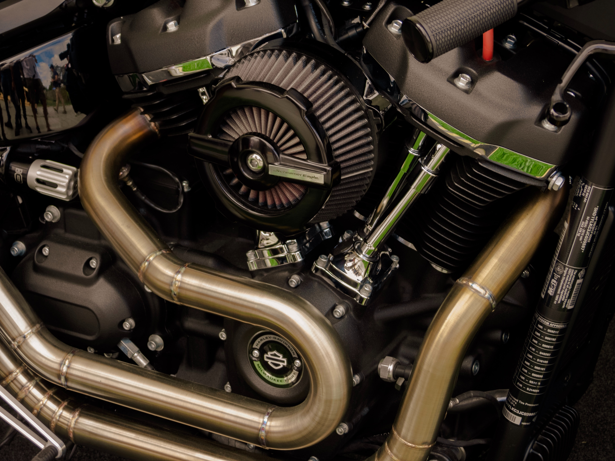
SYSTEM DESIGN

Slide 17
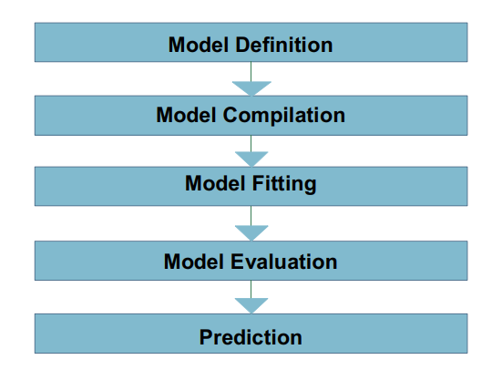
METHODOLOGY
For predicting the red wine quality implementing a small neural network would work rather than a very large deep neural network. A simple five-step model is developed and the prediction is analyzed based on different epochs and batch sizes.

Slide 18
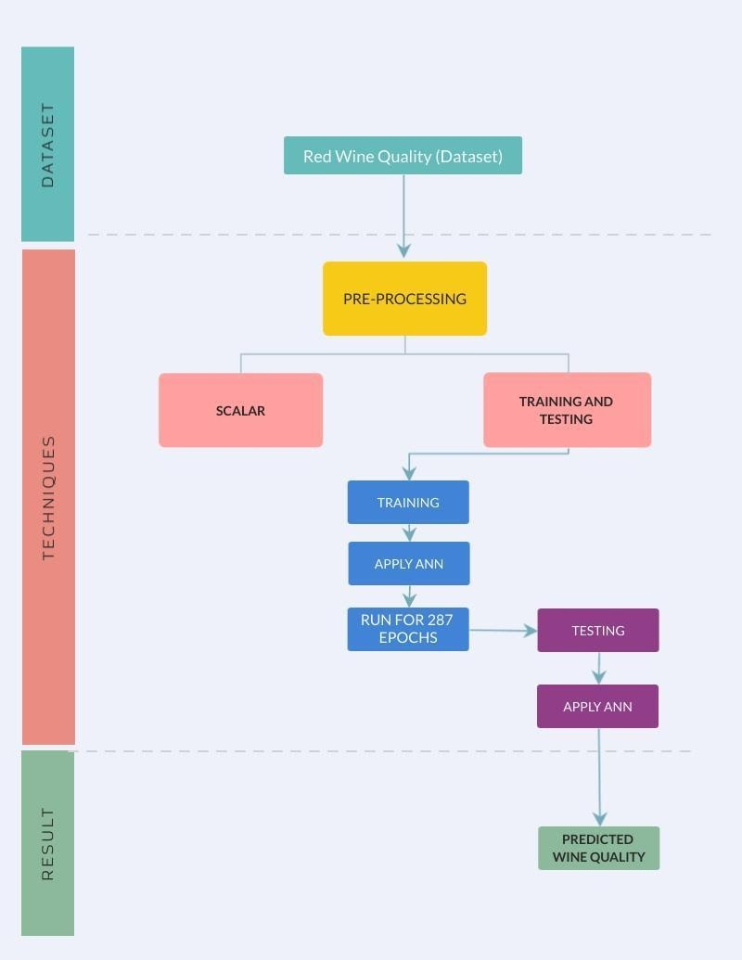
SYSTEM ARCHITECTURE

Slide 19
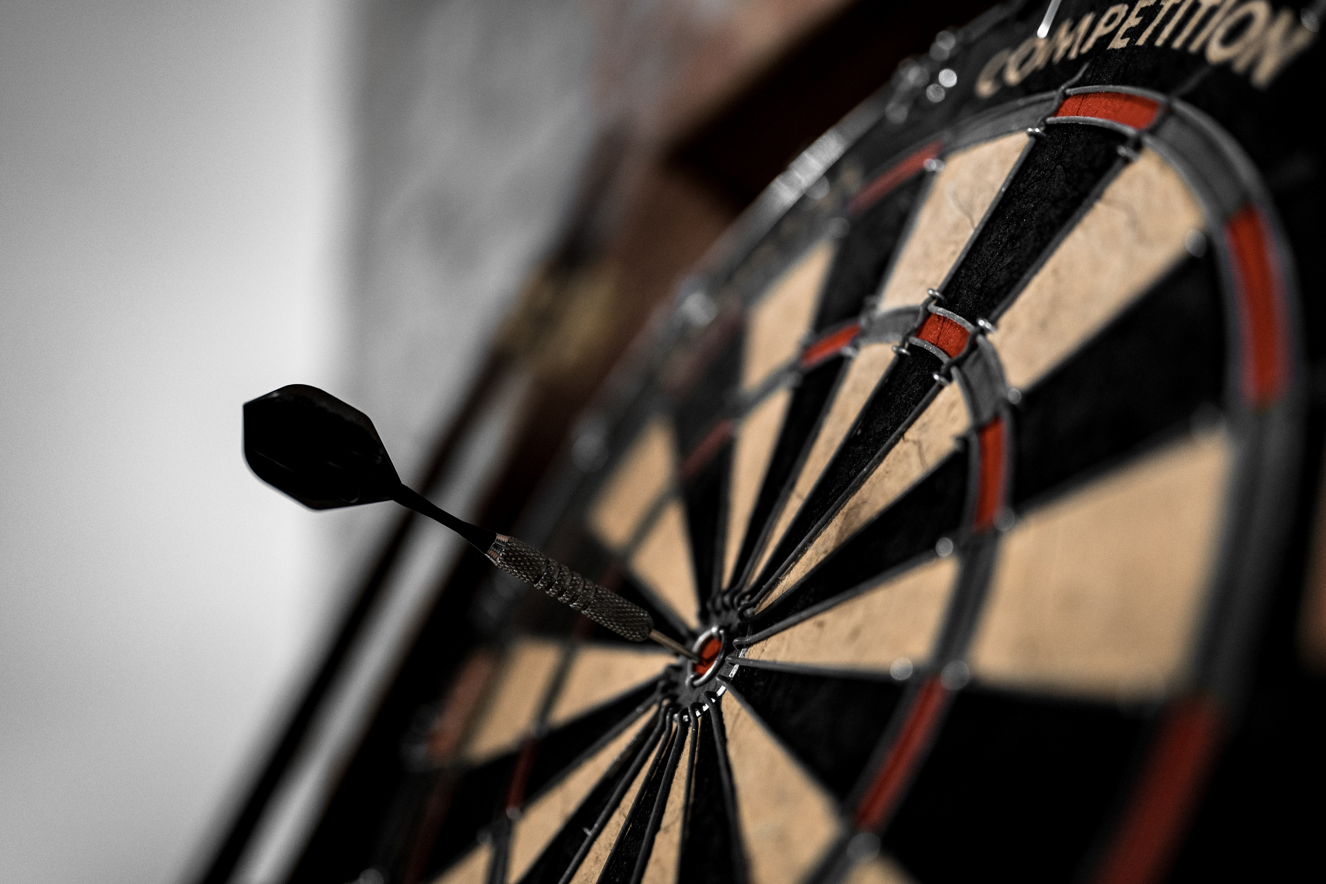
RESULTS & INFERENCE

Slide 20
Model Selection
In Machine Learning, there is no free lunch. Therefore, choosing the algorithm to use depends on several variables, from the type of issue at hand to the type of output that you are looking for.
The aim of model selection is to find the best generalization properties of the network architecture, that is, that which minimizes the error on the data set instances selected.
Five approaches were taken to solve the red-wine quality problem :
- Neural Networks
- Decision Tree
- Random Forest
- AdaBoost
- Gradient Boost

Slide 21
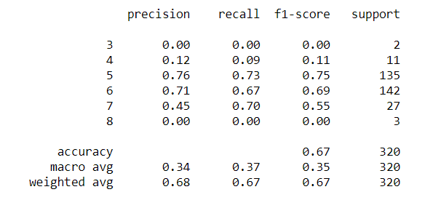
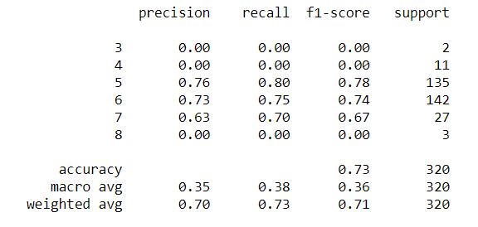
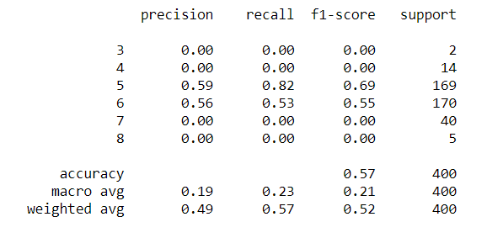
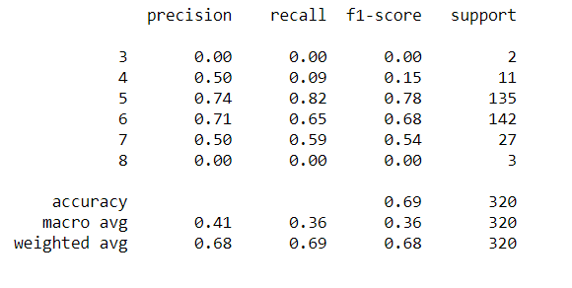
Rejected Approaches
Decision Tree
Random Forest
AdaBoost
Gradient Boost

Slide 22
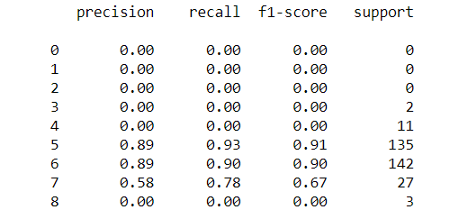

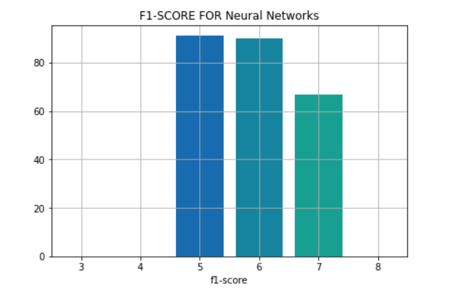
Favored Approach
Neural Networks

Slide 23
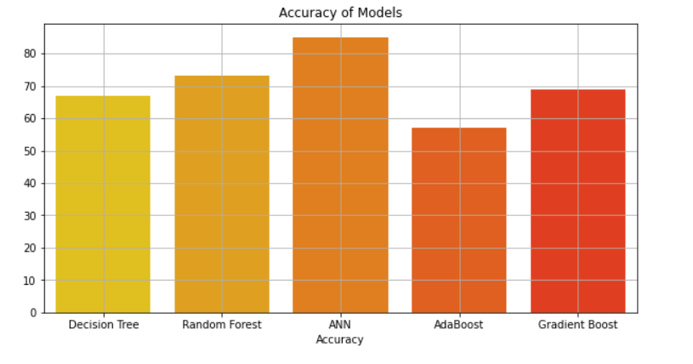
Comparing Accuracy of All Approaches
By comparing all the different approaches we see that the Ann model or the Neural Network model has the highest accuracy and it will be the most suitable model to develop a Prediction Model to determine the Quality of Red Wines distributed.

Slide 24
Conclusion
While participating in this research, and for the duration of this project we have come to the conclusion after our regress analysis and study on the matter that food and beverage industries like- Red-Wine industry, are in desperate and immediate needs of implementation of automated and machine-enabled quality assessment processes.
Further research in this field should take place which will help these companies save cost and help with QA for the customers. We consider our work and report to be a success and with given opportunities try to expand upon our work.
Summing it all up

Slide 25
References
Yogesh Gupta (2017). “Selection of Important Features and Predicting Wine Quality using Machine Learning Techniques” ICSCC 2017
Satyabrata Aich; Ahmed Absi; Kueh Lee Hui; Mangal Sain (2019). “Prediction of Quality for Different Type of Wine based on Different Feature Sets Using Supervised Machine Learning Techniques” ICACT 2019
Devika Pawar; Akansha Mahajan; Sachin Bhoithe (2016). “Wine Quality Prediction using Machine Learning Algorithms” IJCATR Volume 8 Issue 9
Nikita Sharma (2020). “Quality Prediction of Red Wine based on Different Feature Sets Using Machine Learning Techniques” International Journal of Science and Research (IJSR)
Paulo Cortez; Telmo Matos; Jose Luis Reis (2009). “Using Data Mining for Wine Quality Assessment” Discovery Science, 12th International Conference
Prachi Jambhulkar, Vaidehi Baporikar (2015). “Review on Prediction of Heart Disease Using Data Mining Technique with Wireless Sensor Network” NCRMC-2014
Prachi Jambhulkar, Vaidehi Baporikar (2015). “Review on Prediction of Heart Disease Using Data Mining Technique with Wireless Sensor Network” NCRMC-2014

